Slide 1
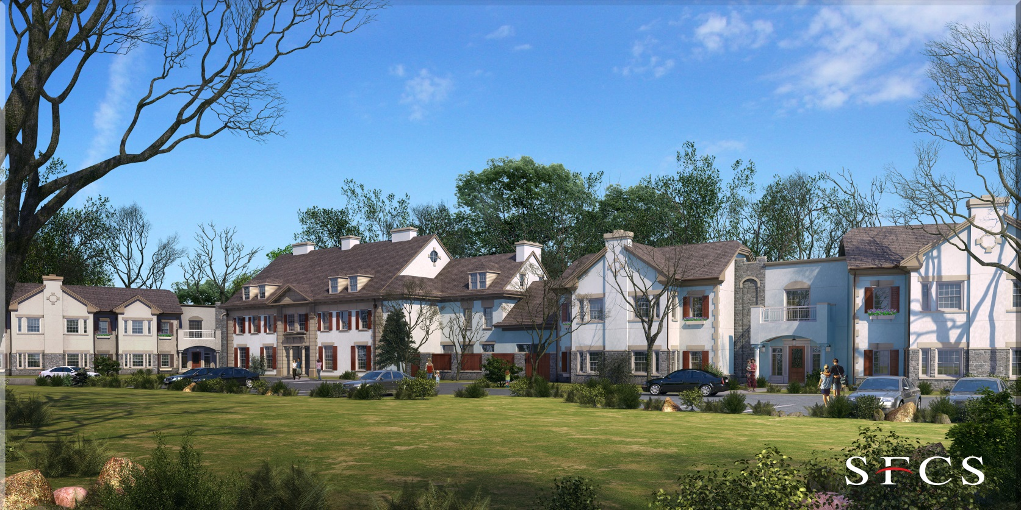
The Mary J. Drexel Home
Assisted Living Addition
Bala Cynwyd, PA
Analysis #3
Green Roof Implementation
Structural Breadth
Acoustical Breadth
Analysis #4
Alternate Delivery Method
Analysis #1
Project Schedule Sequencing
Analysis #2
Prefabricated MEP Corridor Racks
Penn State AE Senior Capstone Project
Gjon Tomaj – Construction Management Option
Advisor: Dr. Ed Gannon
Notes:
Introduction:
Hello my name is Gjon Tomaj and today I will be presenting my senior thesis on the Mary J. Drexel Assisted Living Addition project located just outside Philadelphia in Bala Cynwyd, PA.
In depth research was performed to identify areas in which alternate means and methods could improve the project. These areas include:
Re-sequencing the project schedule
Implementing prefabricated MEP corridor racks
Implementing a green roof system
Altering the project delivery method
Due to time constraints, only 3 of these areas will be presented today (in red).

Slide 2
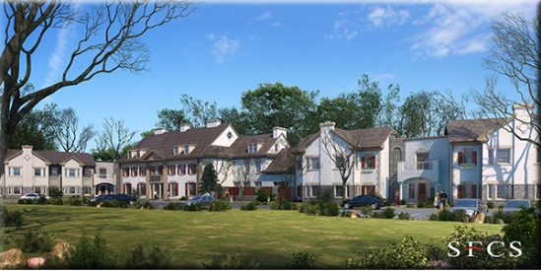

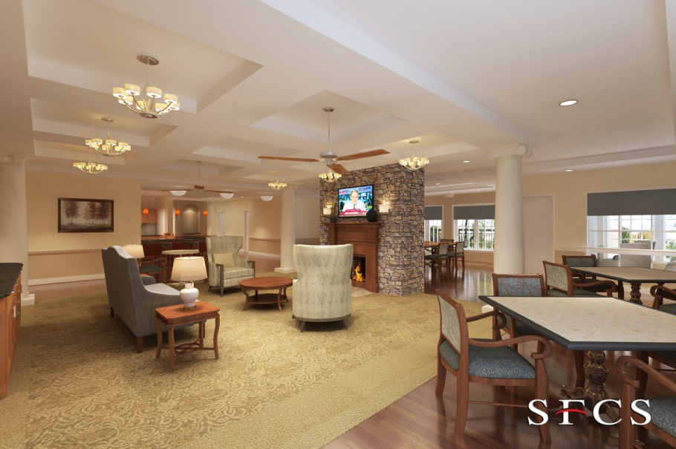
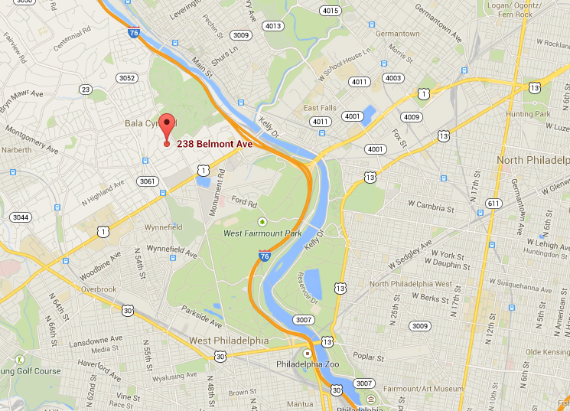
Project Summary
The Mary J. Drexel Home
Assisted Living Addition
Bala Cynwyd, PA
Gjon Tomaj
Construction Management Option
Project Summary
Analysis #1: Project Sequencing
Sequencing Process
Schedule Results
Cost Results
Analysis #2: MEP Corridor Racks
Feasibility
Rack Design
Cost & Schedule Impacts
Analysis #3: Implementation of Green Roof
Structural Breadth
Cost & Schedule Impacts
Final Recommendations
Acknowledgements
Project Location
Bala Cynwd, Pennsylvania
Building Information
Size of West Wing: 34,100 GSF
Size of East Wing: 40,600 GSF
# Stories Above Grade: Two
Structure: Load-Bearing Metal Wall Panels
Size of Existing Mansion: 21,000 GSF
Construction Information
Cost: $14.6 million
Duration: 11/2012 – 12/2013
Delivery: Design-Bid-Build* (*MEP Systems = Design-Build)
Contract Type: GMP
Owner
Client Expectations
Low Cost
High Quality
Construction Completion by February 2014
Project Purpose
Continue senior care excellence started by MJD 150 years ago
Cultural Change Movement
Image Courtesy of Google Maps
Notes:
Project Summary:
Renovation project located in Bala Cynwyd, PA
This $14.6 million project consists of an existing historic mansion that received new attached two-story East and West wings will serve 80 Assisted Living residents. The project had a total construction duration of 14 months.
The reason that this project was constructed by Liberty Lutheran was to continue the tradition of senior care excellence started nearly 150 years ago.
They also believe in a new cultural change movement for senior care in which Liberty Lutheran wants to abandon the institutional concept of senior care facilities and provide a more comfortable “home” feeling environment.
They wanted this to happen by having a high quality project at a low cost and be ready for seniors to move in the Spring of 2014.

Slide 3

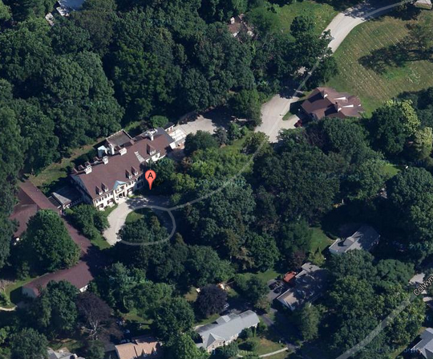
Project Sequencing
The Mary J. Drexel Home
Assisted Living Addition
Bala Cynwyd, PA
Gjon Tomaj
Construction Management Option
Project Summary
Analysis #1: Project Sequencing
Sequencing Process
Schedule Results
Cost Results
Analysis #2: MEP Corridor Racks
Feasibility
Rack Design
Cost & Schedule Impacts
Analysis #3: Implementation of Green Roof
Structural Breadth
Cost & Schedule Impacts
Final Recommendations
Acknowledgements
Problem Identification
No Urgency Placed on Completing Project Faster
Scheduling Gaps
Limited Activity Overlap (Majority Start-to-Finish Activities)
Background Information
Emphasis on Cost & Quality
Simple Cost Effective Fix
General Conditions Overview
Total Cost: $1,596,477
50% of GC Costs Affected by Schedule Changes: $798,384
Analysis Goals
Two Week Reduction
Savings on General Conditions: $28,514
Image Courtesy of Google Maps
Notes:
Analysis #1:
First area analyzed for improvement was the project schedule.
Having experience of being on the project this past Summer, it was noticed that cost and quality were the main focus of this project and not much urgency was placed on completing the project faster.
Many scheduling gaps were seen between activities throughout the entire project schedule and the majority of them were start-to-finish activities.
Since cost was of high importance, the simplest and cheapest way to save general conditions costs would be to re-sequence the project schedule.
The goal of this analysis was to hopefully reduce the substantial completion date by two weeks which would provide a cost savings of $28,514.

Slide 4
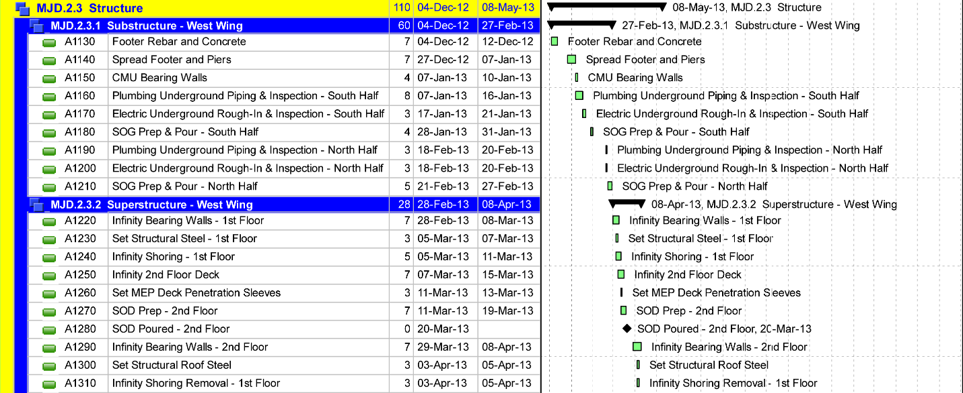
Project Sequencing
The Mary J. Drexel Home
Assisted Living Addition
Bala Cynwyd, PA
Gjon Tomaj
Construction Management Option
Project Summary
Analysis #1: Project Sequencing
Sequencing Process
Schedule Results
Cost Results
Analysis #2: MEP Corridor Racks
Feasibility
Rack Design
Cost & Schedule Impacts
Analysis #3: Implementation of Green Roof
Structural Breadth
Cost & Schedule Impacts
Final Recommendations
Acknowledgements
Example: Original Structure Phase Schedule
Substructure: 60 Days
Superstructure: 28 Days
Majority Start-to-Finish Activities
Re-Sequencing Process
1. Remove Schedule Gaps
2. Re-Sequence Activities
3. Overlap Activities
Notes:
Using the structure phase of the project schedule as an example, it is clearly noticeable how linear the project schedule is with the majority of the activities being start to finish.

Slide 5
Project Sequencing
The Mary J. Drexel Home
Assisted Living Addition
Bala Cynwyd, PA
Gjon Tomaj
Construction Management Option
Project Summary
Analysis #1: Project Sequencing
Sequencing Process
Schedule Results
Cost Results
Analysis #2: MEP Corridor Racks
Feasibility
Rack Design
Cost & Schedule Impacts
Analysis #3: Implementation of Green Roof
Structural Breadth
Cost & Schedule Impacts
Final Recommendations
Acknowledgements
Example: Original Structure Phase Schedule
Substructure: 60 Days
Superstructure: 28 Days
Majority Start-to-Finish Activities
Re-Sequencing Process
1. Remove Schedule Gaps
2. Re-Sequence Activities
3. Overlap Activities
Notes:
The first step in the re-sequencing process was noticing and removing scheduling gaps as seen here.

Slide 6
Project Sequencing
The Mary J. Drexel Home
Assisted Living Addition
Bala Cynwyd, PA
Gjon Tomaj
Construction Management Option
Project Summary
Analysis #1: Project Sequencing
Sequencing Process
Schedule Results
Cost Results
Analysis #2: MEP Corridor Racks
Feasibility
Rack Design
Cost & Schedule Impacts
Analysis #3: Implementation of Green Roof
Structural Breadth
Cost & Schedule Impacts
Final Recommendations
Acknowledgements
Example: Original Structure Phase Schedule
Substructure: 60 Days
Superstructure: 28 Days
Majority Start-to-Finish Activities
Re-Sequencing Process
1. Remove Schedule Gaps
2. Re-Sequence Activities
3. Overlap Activities
Notes:
The next step was then to re-sequencing some activities
As shown, the south half of the prefabricated load-bearing metal panel walls could start once the south half of the SOG reaches 75% of the total compressive strength.
Once delays started arising later on throughout the project on the other wing this sequencing was used by the project team to stay on track. If this was noticed earlier it could have benefited them in the end.

Slide 7
Project Sequencing
The Mary J. Drexel Home
Assisted Living Addition
Bala Cynwyd, PA
Gjon Tomaj
Construction Management Option
Project Summary
Analysis #1: Project Sequencing
Sequencing Process
Schedule Results
Cost Results
Analysis #2: MEP Corridor Racks
Feasibility
Rack Design
Cost & Schedule Impacts
Analysis #3: Implementation of Green Roof
Structural Breadth
Cost & Schedule Impacts
Final Recommendations
Acknowledgements
Example: Original Structure Phase Schedule
Substructure: 60 Days
Superstructure: 28 Days
Majority Start-to-Finish Activities
Re-Sequencing Process
1. Remove Schedule Gaps
2. Re-Sequence Activities
3. Overlap Activities
Notes:
Once activities were re-sequenced then overlapping activities was the final step.
Quick example can be seen here with the MEP under-slab work not overlapping for the South half .
Also, the panels and steel work can start and continue simultaneously.

Slide 8
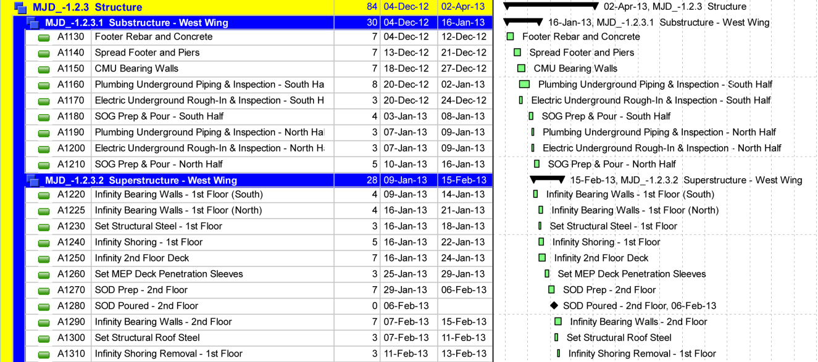
Project Sequencing
The Mary J. Drexel Home
Assisted Living Addition
Bala Cynwyd, PA
Gjon Tomaj
Construction Management Option
Project Summary
Analysis #1: Project Sequencing
Sequencing Process
Schedule Results
Cost Results
Analysis #2: MEP Corridor Racks
Feasibility
Rack Design
Cost & Schedule Impacts
Analysis #3: Implementation of Green Roof
Structural Breadth
Cost & Schedule Impacts
Final Recommendations
Acknowledgements
Revised Structure Phase Schedule
Substructure: 30 Days
Superstructure: 28 Days
Original Activity Durations not changed
Original Substantial Completion | 12/14/13
Revised Substantial Completion | 11/25/13
Revised Duration Results | 4 weeks
Notes:
Once the re-sequencing process was complete for the entire schedule and none of the activity durations were altered, the project schedule saw a 4 week reduction when compared to the original schedule.

Slide 9
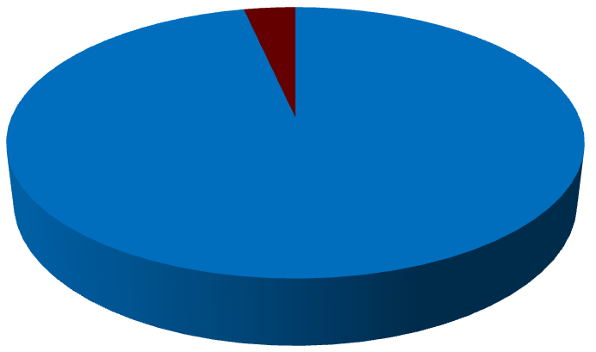
Project Sequencing
The Mary J. Drexel Home
Assisted Living Addition
Bala Cynwyd, PA
Gjon Tomaj
Construction Management Option
Project Summary
Analysis #1: Project Sequencing
Sequencing Process
Schedule Results
Cost Results
Analysis #2: MEP Corridor Racks
Feasibility
Rack Design
Cost & Schedule Impacts
Analysis #3: Implementation of Green Roof
Structural Breadth
Cost & Schedule Impacts
Final Recommendations
Acknowledgements
General Conditions 3.6% Savings
General Conditions Savings Breakdown
Analysis Implications
Cost Schedule
Quality Safety
Original Monthly Items | $798,384
Revised Monthly Items | $741,357
Total Savings | $57,027
3.6% Savings
Notes:
With the reduction in schedule, this means that the general conditions costs will be affected.
In terms of cost savings,
3.6% of the general conditions costs were reduced which achieves a total savings of about $57,000 to the owner.
Quality will increase due to the owner having more time to select higher quality furnishings after completion of the project.

Slide 10
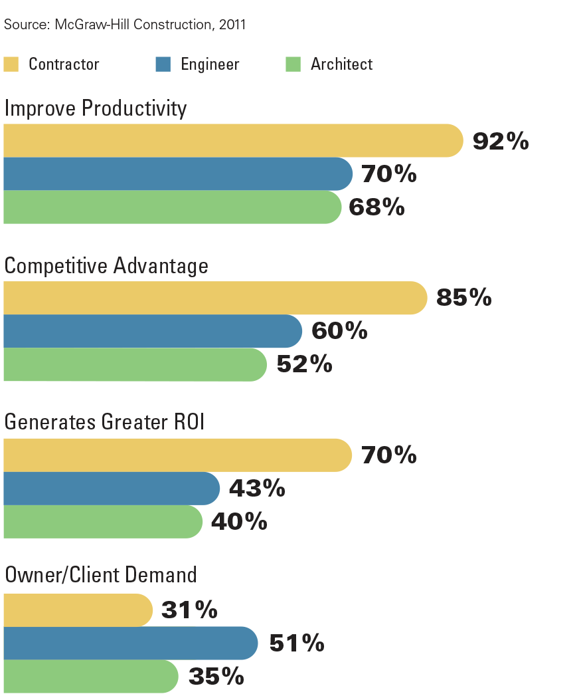
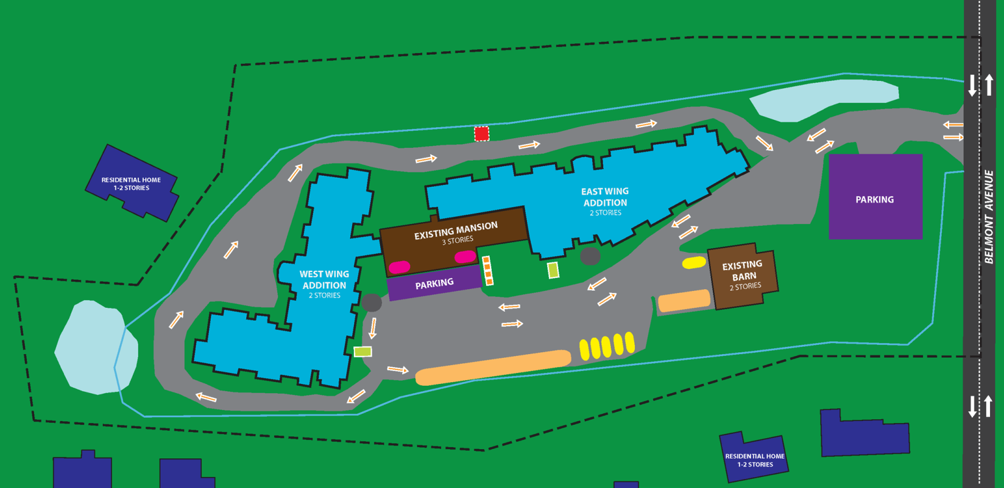
MEP Corridor Racks
The Mary J. Drexel Home
Assisted Living Addition
Bala Cynwyd, PA
Gjon Tomaj
Construction Management Option
Project Summary
Analysis #1: Project Sequencing
Sequencing Process
Schedule Results
Cost Results
Analysis #2: MEP Corridor Racks
Feasibility
Rack Design
Cost & Schedule Impacts
Analysis #3: Implementation of Green Roof
Structural Breadth
Cost & Schedule Impacts
Final Recommendations
Acknowledgements
Key Drivers for Prefab
Problem Identification
Limited Jobsite Access
Unforeseen Delays
MEP Trades forced to increase manpower to meet schedule
Background Information
MEP Systems: Design-Build
Prefabrication due to identical corridor layouts
Analysis Goals
Determine Feasibility Reduce Site Congestion
Reduce Schedule Potential Cost Savings
Notes:
The next area for improvement focuses on utilizing prefabricated MEP corridor racks.
Since the MEP systems were design-build and the subcontractors were brought on early in the project, this seemed like a great possibility to improve the project.
Also, since the jobsite as limited access due to its small size, having the MEP trades perform their work at an off-site facility would have been beneficial in avoiding them to increase manpower to meet schedule demands due to unforeseen delays that were not caused by them.
As shown, according to a McGraw Hill Construction in 2011, the biggest driver for using prefab was to improve productivity on projects.

Slide 11
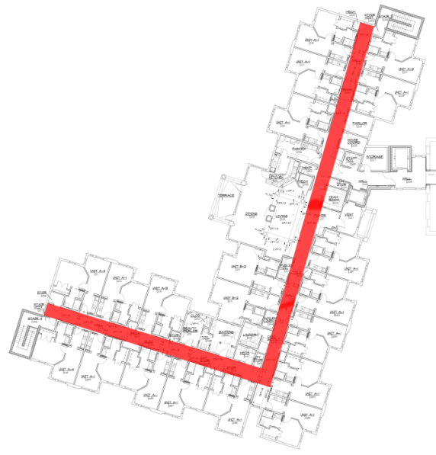
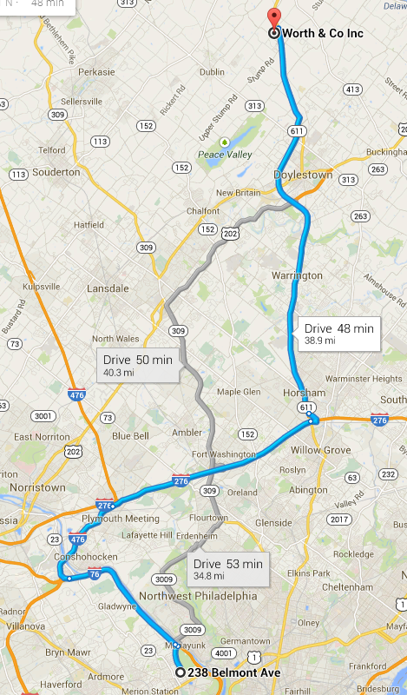
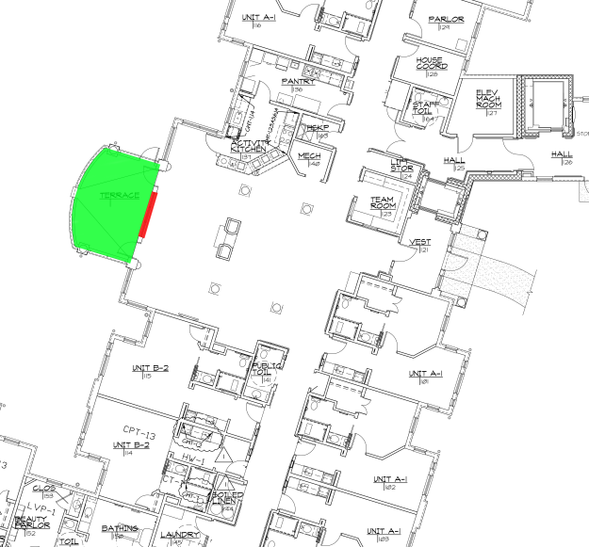
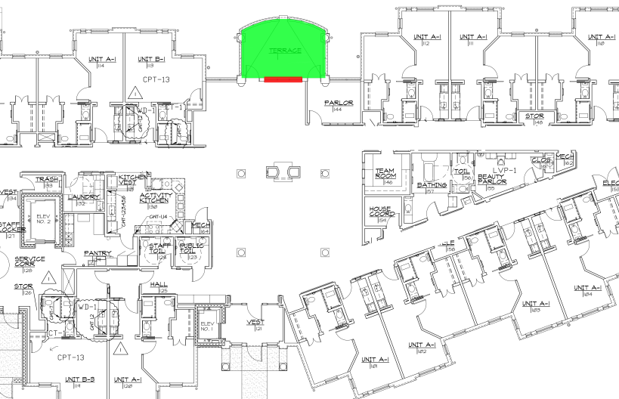
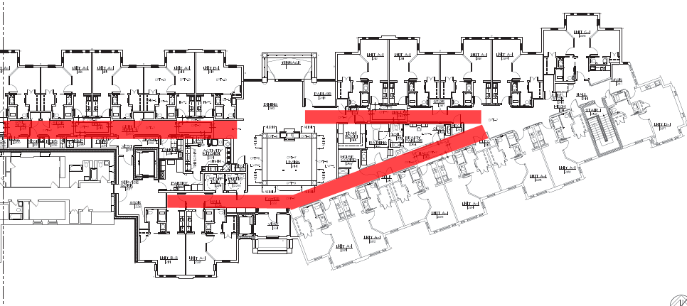
MEP Corridor Racks
The Mary J. Drexel Home
Assisted Living Addition
Bala Cynwyd, PA
Gjon Tomaj
Construction Management Option
Project Summary
Analysis #1: Project Sequencing
Sequencing Process
Schedule Results
Cost Results
Analysis #2: MEP Corridor Racks
Feasibility
Rack Design
Cost & Schedule Impacts
Analysis #3: Implementation of Green Roof
Structural Breadth
Cost & Schedule Impacts
Final Recommendations
Acknowledgements
Prefabrication Warehouse Location
          Distance:
          39 Miles
Area of Implementation
Logistics
West Wing
East Wing
West Wing
East Wing
Image Courtesy of Google Maps
Notes:
In determining the feasibility of using this construction method a few project conditions were analyzed:
The most important aspect is of course the ability to have a pre-fabrication warehouse. Fortunately, Worth & Company, the plumbing subcontractor has this capability which will greatly allow for the push for prefabrication with their warehouse only being 39 miles away from the job site.
identical corridor layouts throughout both East and West wings (6’ wide)
Racks can be brought in though the Terrace Windows (10’ width) and easily be wheeled to their respective locations and jacked up and installed.

Slide 12
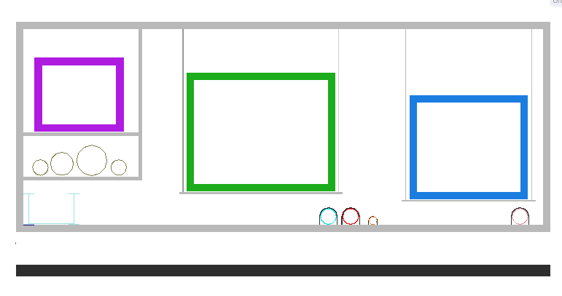
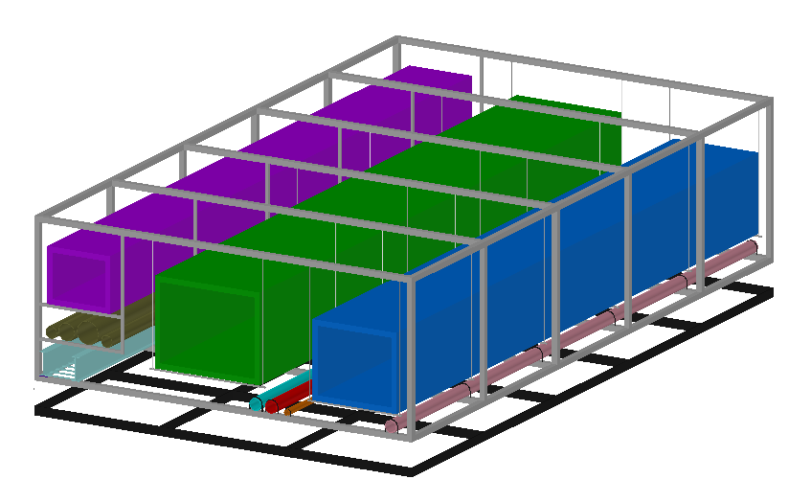
MEP Corridor Racks
The Mary J. Drexel Home
Assisted Living Addition
Bala Cynwyd, PA
Gjon Tomaj
Construction Management Option
Project Summary
Analysis #1: Project Sequencing
Sequencing Process
Schedule Results
Cost Results
Analysis #2: MEP Corridor Racks
Feasibility
Rack Design
Cost & Schedule Impacts
Analysis #3: Implementation of Green Roof
Structural Breadth
Cost & Schedule Impacts
Final Recommendations
Acknowledgements
Design Criteria
Floor to Floor Ht: 11’-6”
Floor to Ceiling Ht: 8’-6”
Corridor Rack:
Width: 6’ max
Height: 2’-6” (6” clearance)
Length: 10’*
*Lengths be adjusted to different lengths if necessary (under professional design)
Sample Design
Notes:
Using the 3d coordination model and the drawings it was very evident that the corridors have the same layout of MEP systems.
Thus, a sample design (using the maximum size ducts) is shown. With a floor-to-floor height of 11.5’ and a ceiling height of 8.5’ that leaves 3’ of above ceiling work to be complete.
Which is more than enough for a MEP rack and allows for plenty of clearance inside the rack for any stick-built connections to be installed.

Slide 13
MEP Corridor Racks
The Mary J. Drexel Home
Assisted Living Addition
Bala Cynwyd, PA
Gjon Tomaj
Construction Management Option
Project Summary
Analysis #1: Project Sequencing
Sequencing Process
Schedule Results
Cost Results
Analysis #2: MEP Corridor Racks
Feasibility
Rack Design
Cost & Schedule Impacts
Analysis #3: Implementation of Green Roof
Structural Breadth
Cost & Schedule Impacts
Final Recommendations
Acknowledgements
Cost Savings
Schedule Savings
Critical Path
25% reduction in labor duration
1.5 Days for each trade per floor
Total Duration Reduction: 6.25 Days (approx. 1 Week)
Analysis Implications
Cost Schedule
Quality Safety
GC Cost Savings | $14,257
Labor Savings/Day | $3,340*
*Assume 5 laborers per each trade
Total Potential Labor Savings | $20,875
Original Corridor Work Duration | 25 days
Prefab Corridor Rack Duration | 18.75 days
Total Reduction | 6.25 days
Notes:
Reduce overall project schedule
Higher quality of construction
Safer environment
The primary reason to use prefabed MEP corridor racks was to attempt to reduce the overall project schedule by achieving a higher quality of construction and doing so in a safer environment.
By the results shown, implementing this method of construction allows for an approximate 1 week schedule reduction, further reducing GC costs by $14,257.
Not only can GC costs be saved, but labor costs associated with on-site vs off-site work provides costs savings as well. The potential labor savings assuming 5 laborers work for each trade could be close to $21,000.
Critical path items tend to be some of the most complex components of a building project and prefab simplifies it.

Slide 14
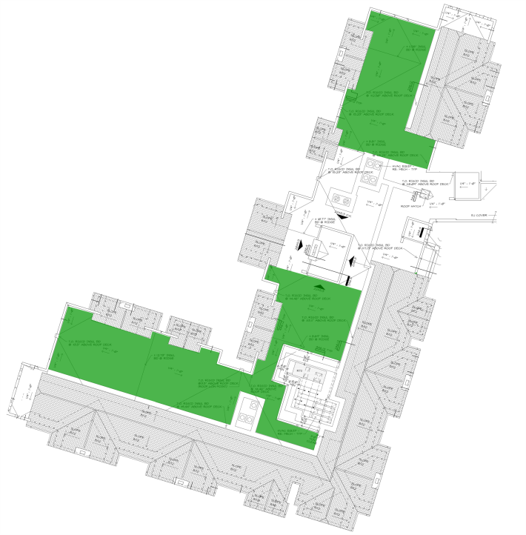
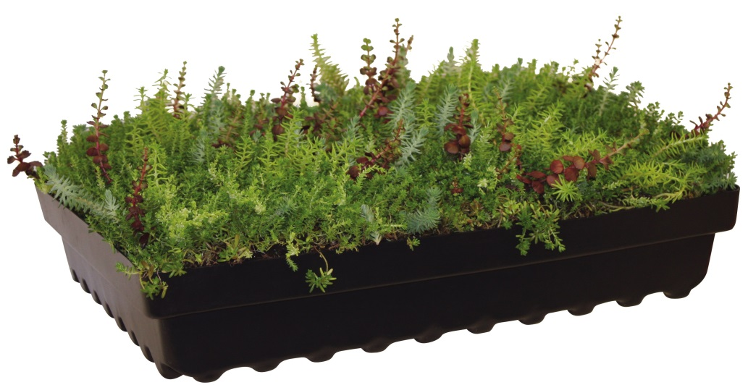
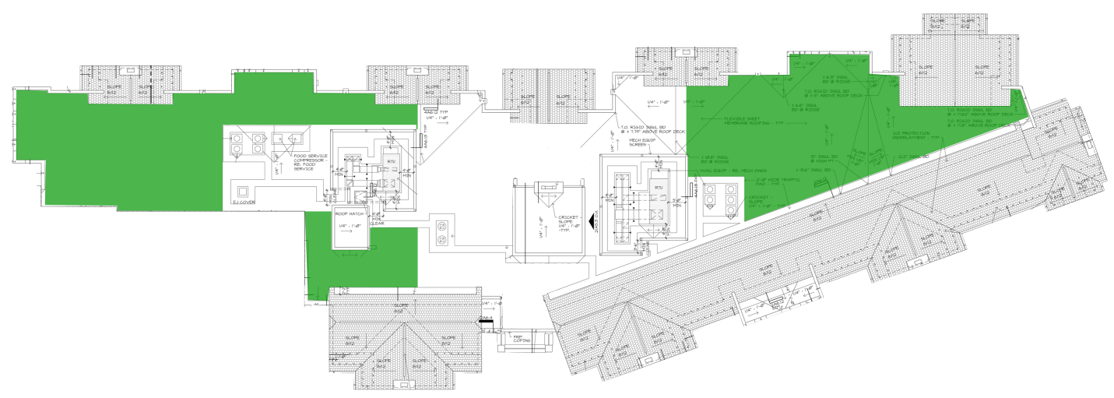
Green Roof Implementation
The Mary J. Drexel Home
Assisted Living Addition
Bala Cynwyd, PA
Gjon Tomaj
Construction Management Option
Project Summary
Analysis #1: Project Sequencing
Sequencing Process
Schedule Results
Cost Results
Analysis #2: MEP Corridor Racks
Feasibility
Rack Design
Cost & Schedule Impacts
Analysis #3: Implementation of Green Roof
Structural Breadth
Cost & Schedule Impacts
Final Recommendations
Acknowledgements
Problem Identification
Very few sustainable VE efforts
Decisions made only to lower initial capital costs
Background Information
Concrete Roof Deck to EPDM Roof
No LEED accreditation
Analysis Goals
Increase quality of project
Provide cost savings over life of project
Green Roof Design
Extensive System
Total Roof Area: 17,000 SF
Green Roof Area: 9,500 SF
Hydrotech® Garden Tray Module
West Wing
Image Courtesy of Hydrotech USA
East Wing
Notes:
Although many VE efforts were made throughout the project to benefit the owner, very few sustainable techniques were considered that could have provided more financial benefit to the owner of the life of the facility.
The VE item that brought this analysis to consideration was the elimination of the concrete roof deck. Instead an EPDM roofing system was approved to be used.
This did allow for initial significant cost savings, however a green roof system may have been more beneficial for long-term savings.
The system proposed would affect the roof above the resident units on both wings which covers approximately 9,500 SF. Leaving 7,500 SF of EPDM to still be used.

Slide 15
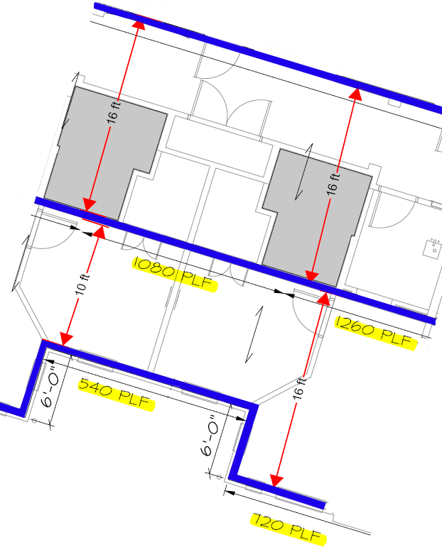
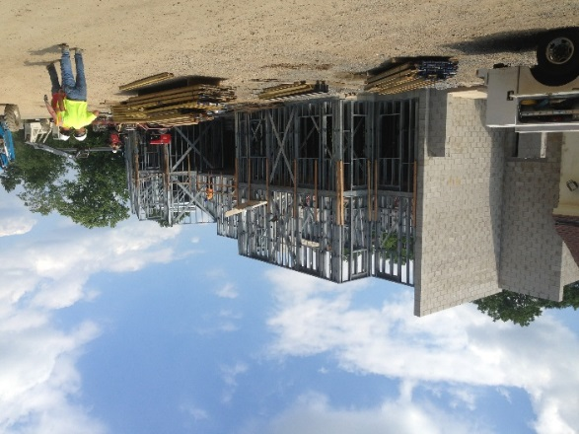
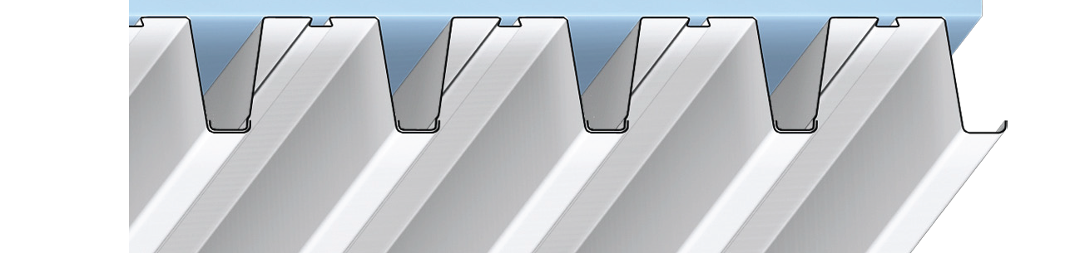
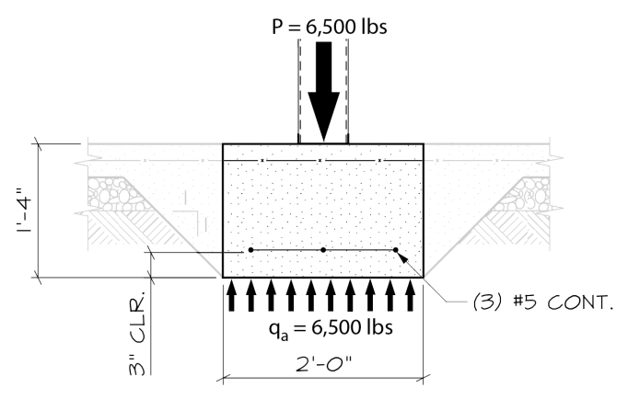
Green Roof Implementation
The Mary J. Drexel Home
Assisted Living Addition
Bala Cynwyd, PA
Gjon Tomaj
Construction Management Option
Project Summary
Analysis #1: Project Sequencing
Sequencing Process
Schedule Results
Cost Results
Analysis #2: MEP Corridor Racks
Feasibility
Rack Design
Cost & Schedule Impacts
Analysis #3: Implementation of Green Roof
Structural Breadth
Cost & Schedule Impacts
Final Recommendations
Acknowledgements
Structural Analysis
Results
Existing Roof Deck | ✓
Metal Wall Panels | ✓
Existing Foundation | ✓
Description | EPDM | Green Roof
Dead Load | 39 psf | 68 psf
Roof Live Load | 20 psf | 20 psf
Snow Load | 23.1 psf | 23.1 psf
Load Difference | - | 29 psf
Notes:
In order to proceed with the analysis further, a structural analysis had to be performed to determine if the addition 29 psf load can be supported.
After performing calculations for the existing metal roof deck, the load-bearing metal wall panels, and the existing foundation, the calculations checked out and the existing structure was acceptable for the new green roof implementation.

Slide 16
Green Roof Implementation
The Mary J. Drexel Home
Assisted Living Addition
Bala Cynwyd, PA
Gjon Tomaj
Construction Management Option
Project Summary
Analysis #1: Project Sequencing
Sequencing Process
Schedule Results
Cost Results
Analysis #2: MEP Corridor Racks
Feasibility
Rack Design
Cost & Schedule Impacts
Analysis #3: Implementation of Green Roof
Structural Breadth
Cost & Schedule Impacts
Final Recommendations
Acknowledgements
Schedule Savings
Cost Analysis
Analysis Implications
Cost Schedule
Quality Safety
Years | EPDM | Green Roof
0 | $279,870 | $378,272
1 | $0 | -$20,700
2 | $0 | -$20,700
3 | $0 | -$20,700
4 | $0 | -$20,700
5 | $0 | -$20,700
6-17 | $0 | $0
18 | $279,870 | $123,143
Total | $559,740 | $397,915
Cost Difference | $161,825
Initial Cost Diff. | $119,102
TOTAL SAVINGS | $42,723
EPMD Lifespan:
18 Years
Green Roof Lifespan:
39+ years
Tax Credit: 25% of cost
for 6 years
Original EPDM Roof | 15 Days (per wing)
Green Roof 9,500 SF | 15 days
EPDM 7,500 SF | 7 days
New Duration | 15 Days (per wing)
Notes:
A modular green roof system was proposed because of the increased installation time over the conventional system.
The original EPDM roof system had a duration of 15 days per wing. After speaking to a hydrotech rep, a typical modular installation for 9,500 SF will take 3-4 days for the trays to be placed. However this does not include the waterproofing membrane that must be placed prior.
900 sf/day waterproofing membrane.
Total GR durations = 15 days
EPDM about half of the duration will take 7 days. Work can continue simultaneously thus the total duration for the GR system is 15 days. No schedule impact.
Although a green roof system does have higher initial costs (yellow), the life cycle cost analysis performed results in a cost savings of $42,723.
This is due primarily to the green roof system having a much longer lifespan than that of the EPDM. Also currently proposes for the state of PA is legislation that will provide tax credit for green roofs in the amount of 25% of the costs for six years. This provides $20,700 of cast savings per year after taxes.

Slide 17
Final Recommendations
The Mary J. Drexel Home
Assisted Living Addition
Bala Cynwyd, PA
Gjon Tomaj
Construction Management Option
Project Summary
Analysis #1: Project Sequencing
Sequencing Process
Schedule Results
Cost Results
Analysis #2: MEP Corridor Racks
Feasibility
Rack Design
Cost & Schedule Impacts
Analysis #3: Implementation of Green Roof
Structural Breadth
Cost & Schedule Impacts
Final Recommendations
Acknowledgements
Savings Summary
Analysis #1
$57,027
Analysis #2
$14,257
Analysis #3
$42,723 (after 18 years)
TOTAL SAVINGS
$71,284 (not incl. Analysis #3 savings)
$114,007
Analysis #1: Project Sequencing
Cost Savings: $57,027
Schedule Savings: 4 weeks
3.6% Reduction in General Condition Costs
Analysis #2: MEP Corridor Racks
Cost Savings: $14,257 + Labor Savings
Schedule Savings: 6.25 Days
Reduced Site Congestion & Increased Laborer Safety
Analysis #3: Green Roof Implementation
Initial Cost Incurred: $119,102
Cost Savings after first replacement: $42,723
Increased Quality
Existing Structural Elements Acceptable
Better Acoustical Performance for Elderly Residents
Notes:
After careful study of each analysis presented today, it is recommended to the owner to consider providing each one on the project.
As mentioned earlier, low cost and high quality were important to the owner and by spending a little time to improve the project schedule and provide prefabrication techniques, a total of $71,284 in just general conditions costs could have been saved.
Although the project was not pursuing LEED accreditation, implementing a green roof system proved to be beneficial to both the owner and occupants. When time would come for the EPDM roof to be replaced, the owner would see $42,723 in savings between the initial cost of the new system and the replacement costs of the old system.
Also a green roof system does provide better acoustical performance for the elderly residents.

Slide 18


Acknowledgements
The Mary J. Drexel Home
Assisted Living Addition
Bala Cynwyd, PA
Gjon Tomaj
Construction Management Option
Project Summary
Analysis #1: Project Sequencing
Sequencing Process
Schedule Results
Cost Results
Analysis #2: MEP Corridor Racks
Feasibility
Rack Design
Cost & Schedule Impacts
Analysis #3: Implementation of Green Roof
Structural Breadth
Cost & Schedule Impacts
Final Recommendations
Acknowledgements
Academic
Dr. Ed Gannon
Dr. Robert Leicht
Dr. Craig Dubler
Penn State AE Faculty
Special Thanks
DJ Wagner HVAC
Infinity Structures, Inc.
Liberty Lutheran Services
PACE Industry Members
SFCS, Inc.
Wohlsen Construction Project Team
Worth and Company
My Family and Friends
Notes:
That concludes my senior thesis presentation on the Mary J. Drexel project and I would like to thank all Penn State AE faculty, the project team, and my family and friends for supporting me throughout the entire process.

Slide 19
Questions?
The Mary J. Drexel Home
Assisted Living Addition
Bala Cynwyd, PA
Gjon Tomaj
Construction Management Option
Project Summary
Analysis #1: Project Sequencing
Sequencing Process
Schedule Results
Cost Results
Analysis #2: MEP Corridor Racks
Feasibility
Rack Design
Cost & Schedule Impacts
Analysis #3: Implementation of Green Roof
Structural Breadth
Cost & Schedule Impacts
Final Recommendations
Acknowledgements
Savings Summary
Analysis #1
$57,027
Analysis #2
$14,257
Analysis #3
$42,723 (after 18 years)
TOTAL SAVINGS
$71,284 (not incl. Analysis #3 savings)
$114,007
Analysis #1: Project Sequencing
Cost Savings: $57,027
Schedule Savings: 4 weeks
3.6% Reduction in General Condition Costs
Analysis #2: MEP Corridor Racks
Cost Savings: $14,257 + Labor Savings
Schedule Savings: 6.25 Days
Reduced Site Congestion & Increased Laborer Safety
Analysis #3: Green Roof Implementation
Initial Cost Incurred: $119,102
Cost Savings after first replacement: $42,723
Increased Quality
Existing Structural Elements Acceptable
Better Acoustical Performance for Elderly Residents
Notes:
Any questions?

Slide 20
Appendix – Project Sequencing
The Mary J. Drexel Home
Assisted Living Addition
Bala Cynwyd, PA
Gjon Tomaj
Construction Management Option
Project Summary
Analysis #1: Project Sequencing
Sequencing Process
Schedule Results
Cost Results
Analysis #2: MEP Corridor Racks
Feasibility
Rack Design
Cost & Schedule Impacts
Analysis #3: Implementation of Green Roof
Structural Breadth
Cost & Schedule Impacts
Final Recommendations
Acknowledgements

Slide 21
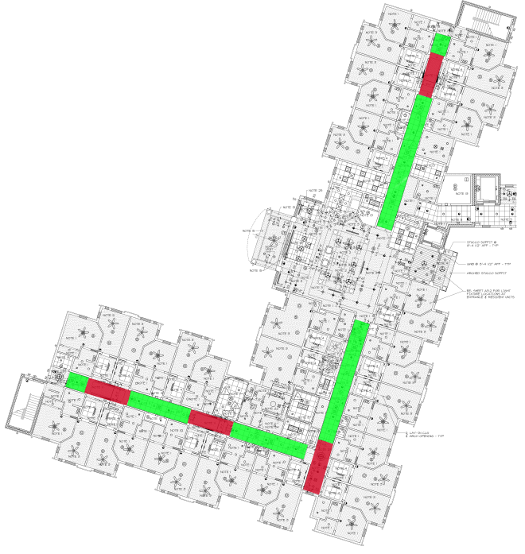
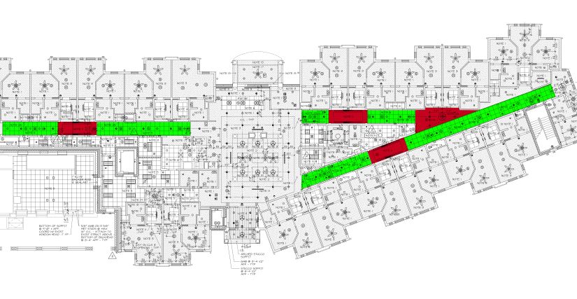
Appendix – MEP Corridor Racks
The Mary J. Drexel Home
Assisted Living Addition
Bala Cynwyd, PA
Gjon Tomaj
Construction Management Option
Project Summary
Analysis #1: Project Sequencing
Sequencing Process
Schedule Results
Cost Results
Analysis #2: MEP Corridor Racks
Feasibility
Rack Design
Cost & Schedule Impacts
Analysis #3: Implementation of Green Roof
Structural Breadth
Cost & Schedule Impacts
Final Recommendations
Acknowledgements

Slide 22

Appendix – MEP Corridor Racks
The Mary J. Drexel Home
Assisted Living Addition
Bala Cynwyd, PA
Gjon Tomaj
Construction Management Option
Project Summary
Analysis #1: Project Sequencing
Sequencing Process
Schedule Results
Cost Results
Analysis #2: MEP Corridor Racks
Feasibility
Rack Design
Cost & Schedule Impacts
Analysis #3: Implementation of Green Roof
Structural Breadth
Cost & Schedule Impacts
Final Recommendations
Acknowledgements

Slide 23
Appendix – Green Roof
The Mary J. Drexel Home
Assisted Living Addition
Bala Cynwyd, PA
Gjon Tomaj
Construction Management Option
Project Summary
Analysis #1: Project Sequencing
Sequencing Process
Schedule Results
Cost Results
Analysis #2: MEP Corridor Racks
Feasibility
Rack Design
Cost & Schedule Impacts
Analysis #3: Implementation of Green Roof
Structural Breadth
Cost & Schedule Impacts
Final Recommendations
Acknowledgements
Years | EPDM | Green Roof
0 | $279,870 | $378,272
1 | $0 | -$20,700
2 | $0 | -$20,700
3 | $0 | -$20,700
4 | $0 | -$20,700
5 | $0 | -$20,700
6-17 | $0 | $0
18 | $279,870 | $123,143
Total | $559,740 | $397,915
Cost Difference | $161,825
Initial Cost Diff. | $119,102
TOTAL SAVINGS | $42,723

Slide 24
Appendix – Green Roof
The Mary J. Drexel Home
Assisted Living Addition
Bala Cynwyd, PA
Gjon Tomaj
Construction Management Option
Project Summary
Analysis #1: Project Sequencing
Sequencing Process
Schedule Results
Cost Results
Analysis #2: MEP Corridor Racks
Feasibility
Rack Design
Cost & Schedule Impacts
Analysis #3: Implementation of Green Roof
Structural Breadth
Cost & Schedule Impacts
Final Recommendations
Acknowledgements

Slide 25

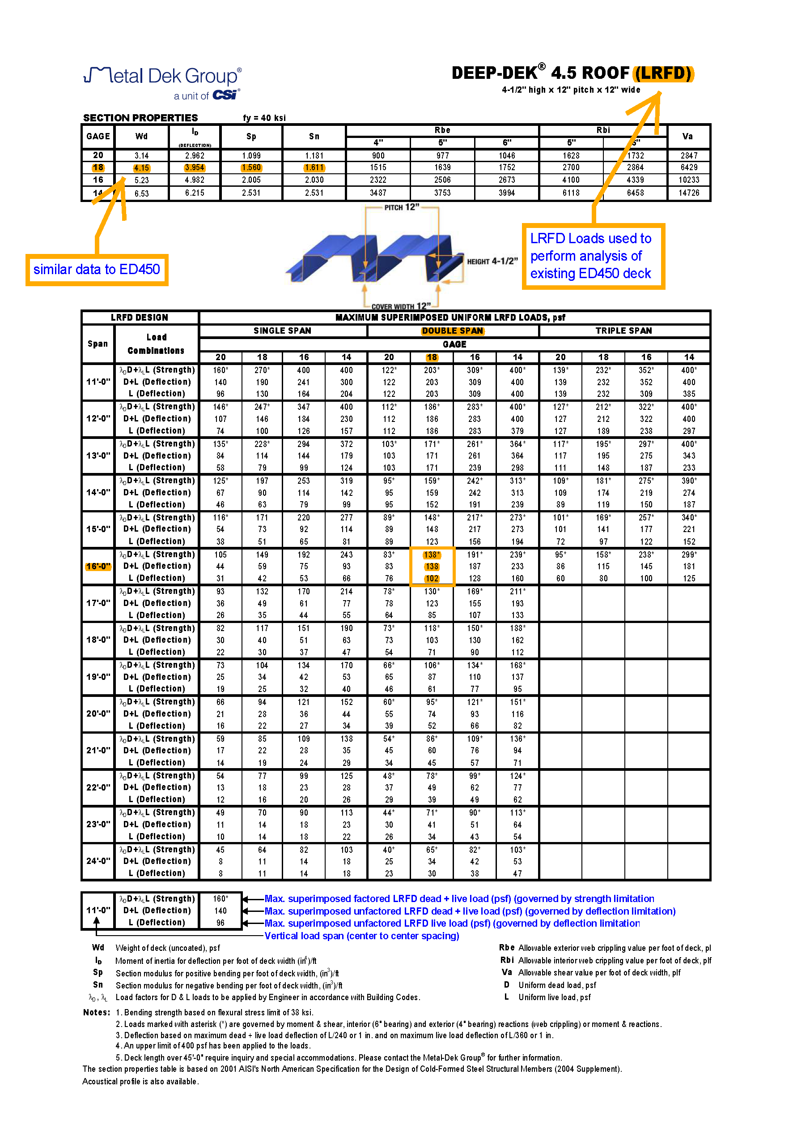
Appendix – Green Roof
The Mary J. Drexel Home
Assisted Living Addition
Bala Cynwyd, PA
Gjon Tomaj
Construction Management Option
Project Summary
Analysis #1: Project Sequencing
Sequencing Process
Schedule Results
Cost Results
Analysis #2: MEP Corridor Racks
Feasibility
Rack Design
Cost & Schedule Impacts
Analysis #3: Implementation of Green Roof
Structural Breadth
Cost & Schedule Impacts
Final Recommendations
Acknowledgements

Slide 26
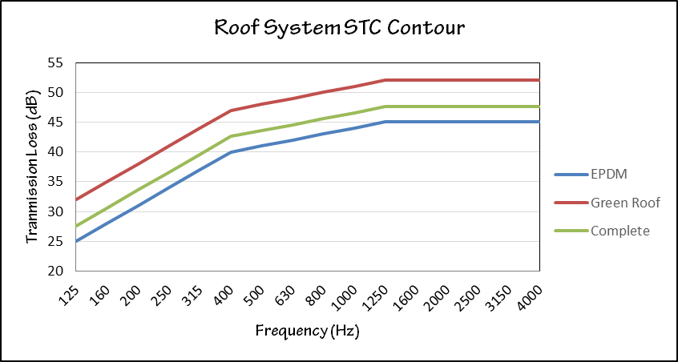
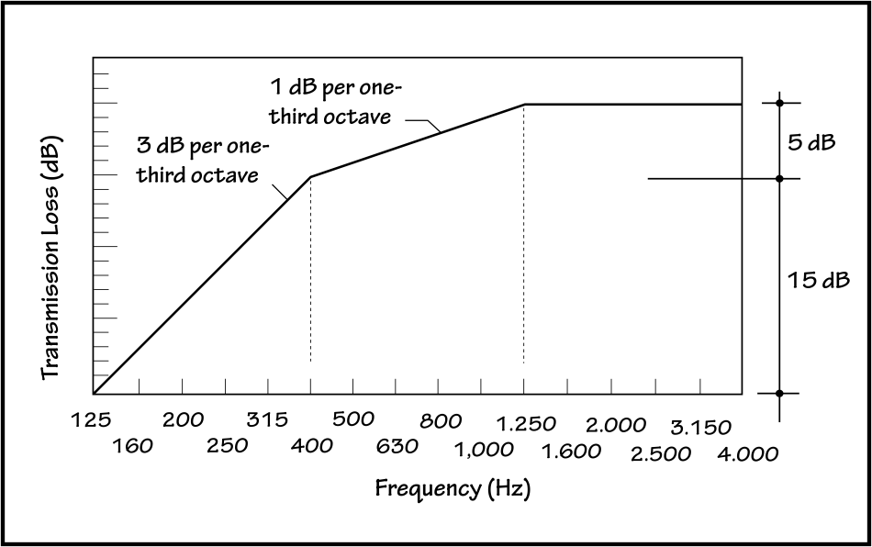
Appendix – Green Roof
The Mary J. Drexel Home
Assisted Living Addition
Bala Cynwyd, PA
Gjon Tomaj
Construction Management Option
Project Summary
Analysis #1: Project Sequencing
Sequencing Process
Schedule Results
Cost Results
Analysis #2: MEP Corridor Racks
Feasibility
Rack Design
Cost & Schedule Impacts
Analysis #3: Implementation of Green Roof
Structural Breadth
Cost & Schedule Impacts
Final Recommendations
Acknowledgements
EPDM STC: 41 Green Roof STC: 48
Complete System STC: 44

Slide 27
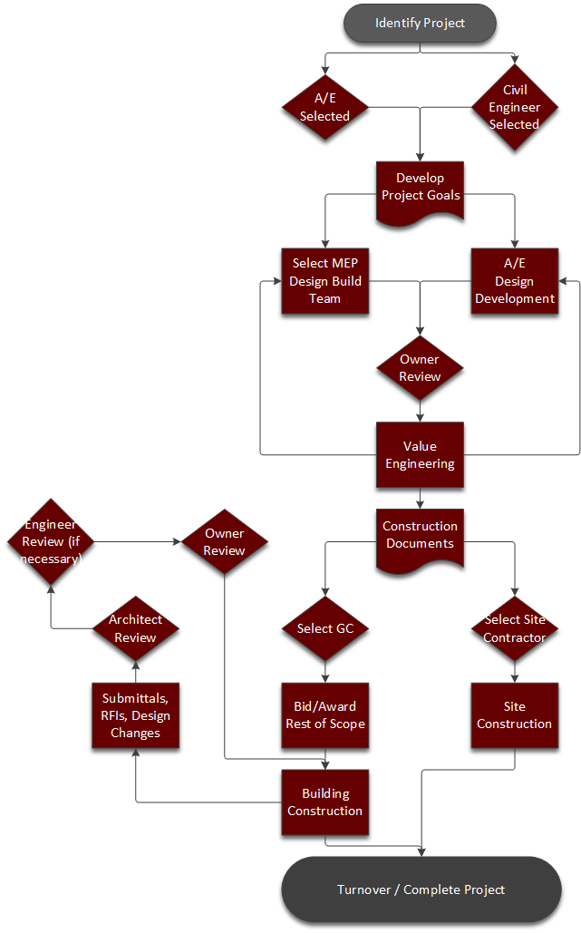
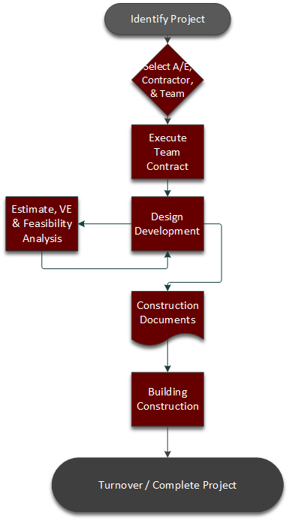
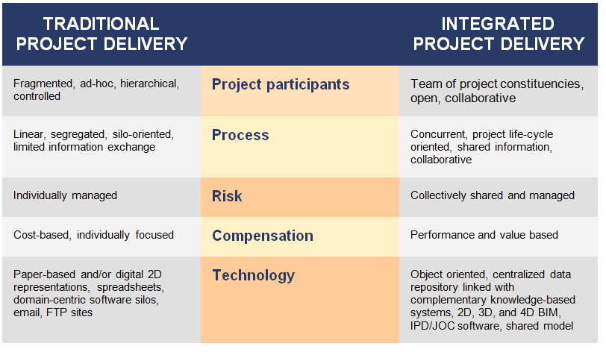
Appendix –Alternate Delivery
The Mary J. Drexel Home
Assisted Living Addition
Bala Cynwyd, PA
Gjon Tomaj
Construction Management Option
Project Summary
Analysis #1: Project Sequencing
Sequencing Process
Schedule Results
Cost Results
Analysis #2: MEP Corridor Racks
Feasibility
Rack Design
Cost & Schedule Impacts
Analysis #3: Implementation of Green Roof
Structural Breadth
Cost & Schedule Impacts
Final Recommendations
Acknowledgements
Traditional Delivery vs. IPD – Image from Building Information Management
IPD Project Delivery Process Map
Hybrid Project Delivery (DBB + DB) Process Map

